Slide 1
Radio Frequency Readout Device (RFRD) Phase - II
Fall 2017

Slide 2
Group 11
Advisors
Dr. Daji Qiao
Dr. Nathan Neihart
Graduate Students
Scott Melvin
Chengrui Yang
Students
Bailey Akers
Colin Sunderman
Nathan Mulbrook
Lyle Bishop
Pengyu Qu

Slide 3
Problem Statement
Purpose:
To reduce the time it takes to check tightness of nut on anchor bolts
Each nut is torqued manually to check tightness
Solution:
Create an Radio Frequency Readout Device (RFRD)
Passively powered from the RF reader
Measures tightness of the nut by measuring the capacitance of two washers
As nut loosens, capacitance decreases
Washer has tag attached

Slide 4
Functional Requirements
Wireless operation
Passively powered tag
Measure capacitance of washers
Send data back to reader
Operating environment
Not addressed in this design

Slide 5
Non-Functional Requirements
Conforms to FCC Regulations
ISM (902-928MHz)
Size
Components have potential to be scaled down in future revisions
Reasonable cost

Slide 6
Market Survey
RFRD Readers and Tags
Implemented in market products
Measuring bolt tightness using RFRD
Implemented in certain research applications
Our application is unique in measuring bolt tightness
By measuring capacitance of the washers

Slide 7
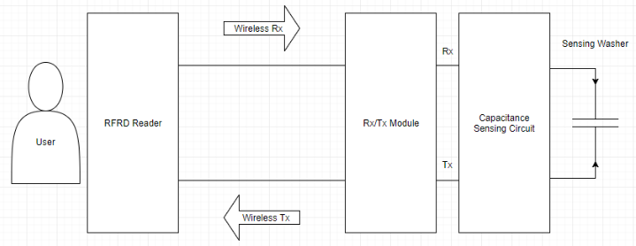
System Block Diagram
Notes:
Slide before add subteams

Slide 8
Design Groups
Capacitance Measuring
Bailey Akers and Colin Sunderman
Antenna and Power Harvesting
Lyle Bishop and Pengyu Qu
RFRD Communication Protocol / Microcontroller
Nathan Mulbrook

Slide 9
Capacitance Measurement Functional Requirements
Operate with low power
Antenna team research
Approximately 0.45mW expected
Measure capacitance from 20pF to 50pF
LCR measurements performed on washer
Notes:
Slide before add subteams

Slide 10
Relaxation Oscillator
Creates a PWM signal
Period is dependent on capacitance

Slide 11
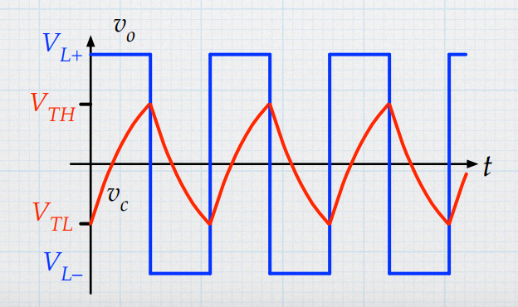
Relaxation Oscillator
V_{TH}
V_{TH} = V_{out}/2, if R_{a} = R_{b} and V_{ref} = 0
V_{i} > V_{TH}, then V_{out} = V_{L-}
V_{i} < V_{TH}, then V_{out} = V_{L+}

Slide 12
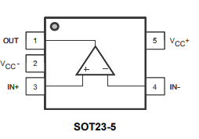
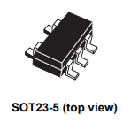
Comparator – TS881
Manufacturer: STMicroelectronics
Low power comparator
Supply voltage 0.85 V to 5.5 V
220 nA typical supply current
No load, output high
Operates at approximately 1 uW
Assuming +/- 1.8 V supply
SPICE model

Slide 13
Simulation
Calculated Period:
T = 55us for C = 50pF
T = 33us for C = 30pF

Slide 14
C = 50pF
Simulated: T = 53us
Calculated: T = 55us

Slide 15
C = 30pF
Simulated: T = 35us
Calculated: T = 33us

Slide 16
Conclusion
The relaxation oscillator allows us to calculate the capacitance
Can use R_{a} and R_{b} to control the voltage the capacitor charges to
Can use R and C to control the period of the pulse widths

Slide 17
Capacitance Measurement Test Plan
Prototype the design on breadboard
Test for different values of capacitances and resistors and verify that results are consistent
Tune the oscillation frequency
Balance power, microcontroller design, and quality of measurement
Find the amount of power consumed

Slide 18
Antenna Design
Inverted F antenna
More compact
Microstrip format
900MHz
Estimated power from similar applications
Fractal loop antenna

Slide 19
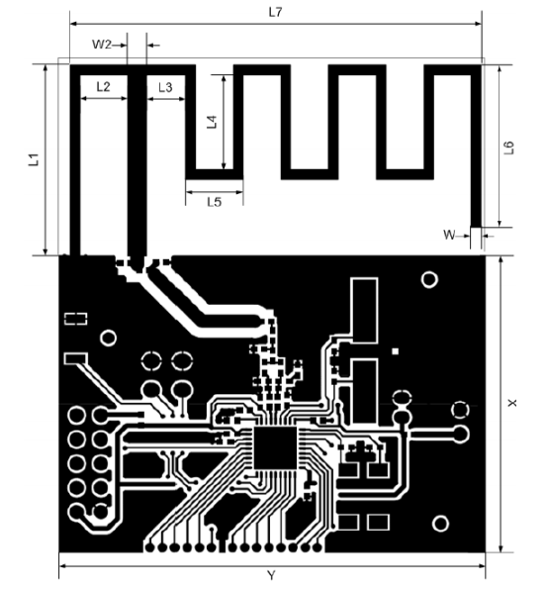
Antenna Design

Slide 20
Antenna Test Plan
Simulating antenna design in ADS
Creating rectifier in PSpice

Slide 21
Future Plans
Antenna simulation
Tune antenna to 900 MHz
Need to simulate rectifier
PSPICE
Couple rectifier to antenna
ADS
Possible backscatter implementation

Slide 22
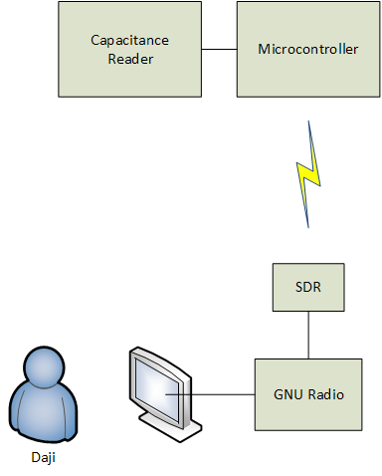
RFRD Communications Design
Radio Transmitter
Send power to the tag
SDR
Receives data from tag
GNU Radio
Process received signal

Slide 23
RFRD Communications Requirements
Unique Identifiers for Tag
Transmission integrity
Checksum
Microcontroller
Low power

Slide 24
Project Status
Capacitance Measuring
Simulated design with TS88
Ordered TS881
Breadboard prototype
Antenna
DN023 Inverted-F design
Simulating using ADS software
RFRD Communication Protocol
Plan for implementation

Slide 25
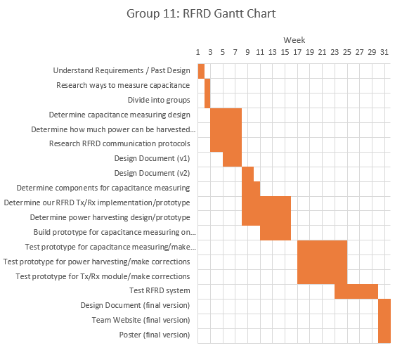
Notes:
Move to future plans slide. Highlight current progress.

Slide 26
Future Plans
Capacitance Measuring:
Build circuit and test
Antenna Design:
Simulate antenna
Design and simulate a rectifier
Communications Design:
Implement receiver in GNU Radio
Write software for microcontroller
Notes:
Add Gantt chart afterwards

Slide 27
References
Liu, Yili, et al. “Limitations of a relaxation oscillator in capacitance measurements.” IEEE Transactions on Instrumentation and Measurement, vol. 49, no. 5, 2000, pp. 980–983., doi:10.1109/19.872917.
Tuttle, Dr. Gary. “Non Linear Oscillators.” EE 230 Website, Dr. Gary Tuttle, tuttle.merc.iastate.edu/ee230/topics/op_amps/non_linear_oscillators.pdf.
“TS881 Rail-To-Rail 0.9 V nanopower comparator.” www.st.com/content/ccc/resource/technical/document/datasheet/a2/60/3e/5d/b2/c1/4a/e9/DM00057901.pdf/files/DM00057901.pdf/jcr:content/translations/en.DM00057901.pdf.
Zeng, Miaowang, et al. “A Compact Fractal Loop Rectenna for RF Energy Harvesting.” IEEE Antennas and Wireless Propagation Letters, vol. 16, 2017, pp. 2424–2427., doi:10.1109/lawp.2017.2722460.
Kervel, Fredirk. “868 MHz, 915 MHz and 955 MHz Inverted F Antenna.” www.ti.com/lit/an/swra228c/swra228c.pdf.

