Slide 1
Radio Frequency Readout Device (RFRD)
Spring 2018

Slide 2
Group 11
Advisors/Clients
Dr. Daji Qiao
Dr. Nathan Neihart
Graduate Students
Scott Melvin
Chengrui Yang
Students
Bailey Akers
Colin Sunderman
Nathan Mulbrook
Pengyu Qu

Slide 3
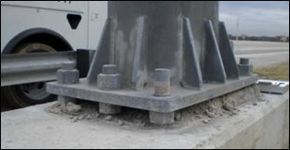
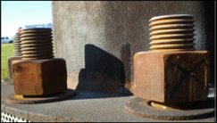
Problem Statement
Purpose:
Reduce field time while manually checking nut tightness on anchor bolts

Slide 4
Problem Statement
Solution:
Create an Radio Frequency Readout Device (RFRD)
Passively powered
Measures tightness of the nut by measuring the capacitance of two washers
As nut loosens, capacitance decreases
Indicate whether the nut is tight or loose to signal servicing

Slide 5
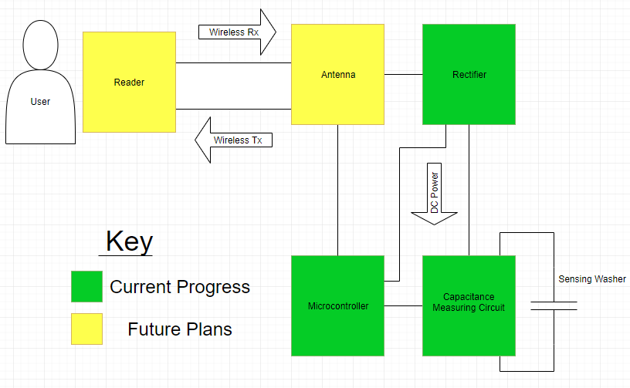
System Block Diagram
Notes:
Slide before add subteams

Slide 6
Functional Requirements
Wireless operation
Passively powered
Measure capacitance of washer design
Visual indication of nut tightness
Operating environment
Not addressed in this design
Indoor conditions

Slide 7
Non-Functional Requirements
Conforms to FCC Regulations
ISM frequencies
Size
Components have potential to be scaled down in future revisions
Reasonable cost
Relevant standard
1720-2012-IEEE Recommended Practice for Near-Field Antenna Measurements

Slide 8
Design Groups
Antenna and Rectifier
Pengyu Qu
Capacitance Measuring
Bailey Akers and Colin Sunderman
Microcontroller
Nathan Mulbrook

Slide 9
Antenna/Rectifier Design
Inverted F antenna
Compact in size
Microstrip format
Central operating frequency: ~950 MHz
Can be operated at ISM frequencies (~915 MHz)
Rectifier
2V/100uW output minimum
Simulated at 915 MHz

Slide 10
Antenna Design

Slide 11
Antenna Test Results
Central frequency: 950 MHz

Slide 12
Rectifier Design

Slide 13
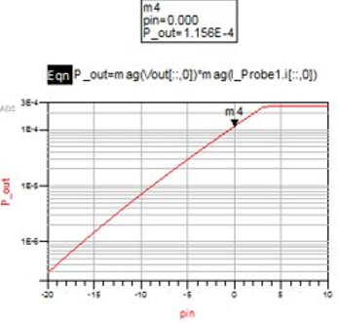
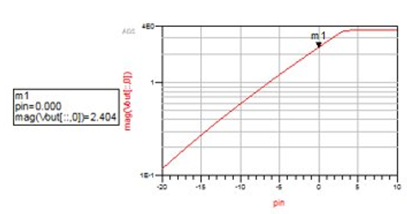
Rectifier Test Results
Simulations at 0 dBm input:
Output voltage: 2.404 V
Output power: 115.6 uW
Power Conversion Efficiency (PCE): 0.116

Slide 14
Antenna/Rectifier PCB layout

Slide 15
Capacitance Measurement Functional Requirements
Operate with low power
- Rectifier supplies up to
115.6 uW
Measure capacitance from 20pF to 600pF
Measure capacitance of washer design
- 20 pF resting washers
- 30-40 pF pressured washers
Notes:
Slide before add subteams

Slide 16
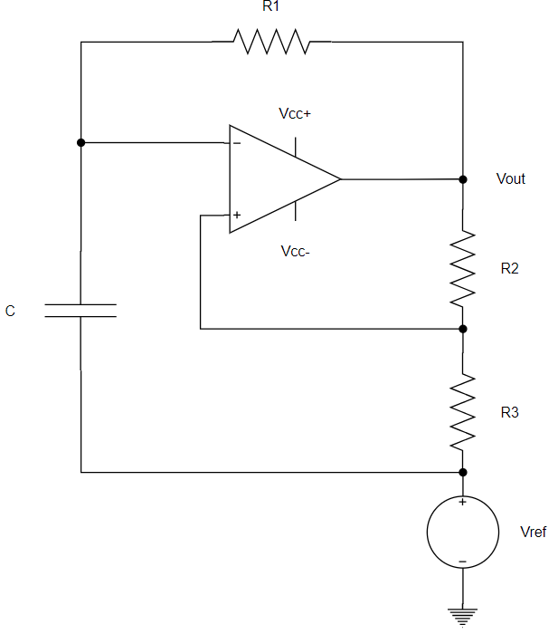
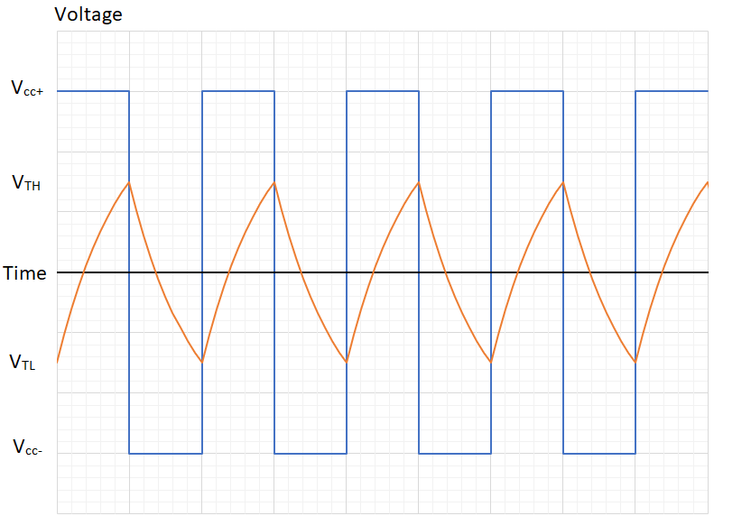
Relaxation Oscillator
V_{TH} = V_{out}/2, if R_{a} = R_{b} and V_{ref} = 0
V_{i} > V_{TH}, then V_{out} = V_{L-}
V_{i} < V_{TH}, then V_{out} = V_{L+}

Slide 17
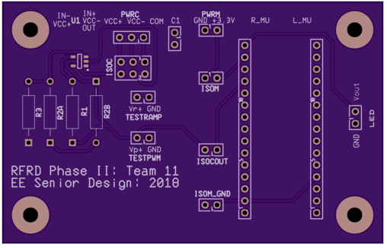
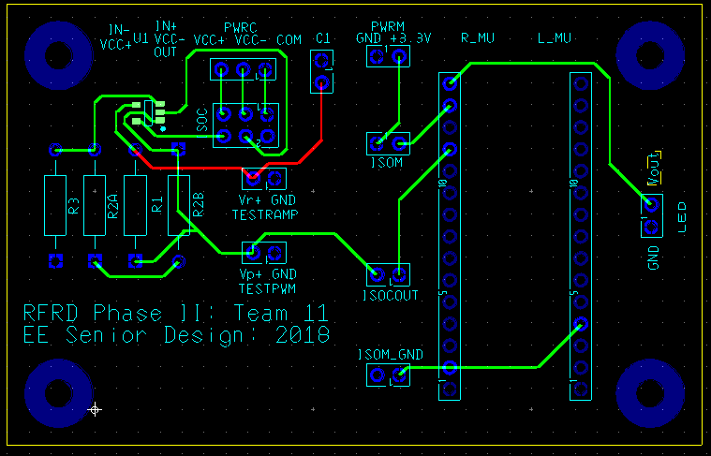
Capacitance Measuring / Microcontroller PCB
Outputs pulse wave
Low power (44.5 uW measured)
Designed with test and isolation points
Vcc+ = 2V, Vcc- = 0V, COM = 1V

Slide 18
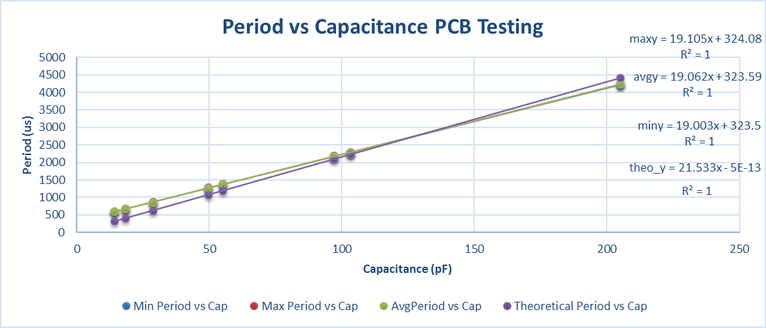
Capacitance Measuring / Microcontroller PCB Testing
Period linearly dependent on capacitance measured

Slide 19
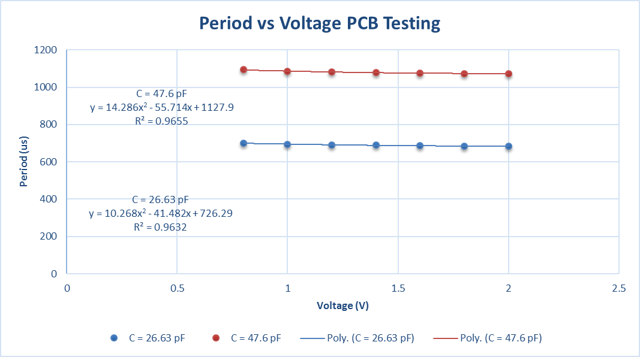
Capacitance Measuring / Microcontroller PCB Testing
Acceptable power supply rejection ratio

Slide 20
Microcontroller Design
Microcontroller
STM32L011K4 low power ARM
Nucleo development board
Small package size
Measure signal from capacitance measuring circuit
Turn LED on at threshold period
Corresponds to nut tightness
Demonstrated with threshold of 30 pF

Slide 21
Toolchain
System Workbench for STM32
Eclipse
CubeMX
Peripheral initialization
Clock initialization

Slide 22
Signal Measurement
Threshold frequency calculated at compile
Uses low power timer as a counter
Triggers on rising edge
Counts for 1000ms
Measured frequency is compared to threshold and GPIO outputs are set

Slide 23
Testing and Verification
UART and debugging was not available for testing of final firmware version
Test various threshold values and ensure operation
Test current draw to ensure proper low power operation

Slide 24
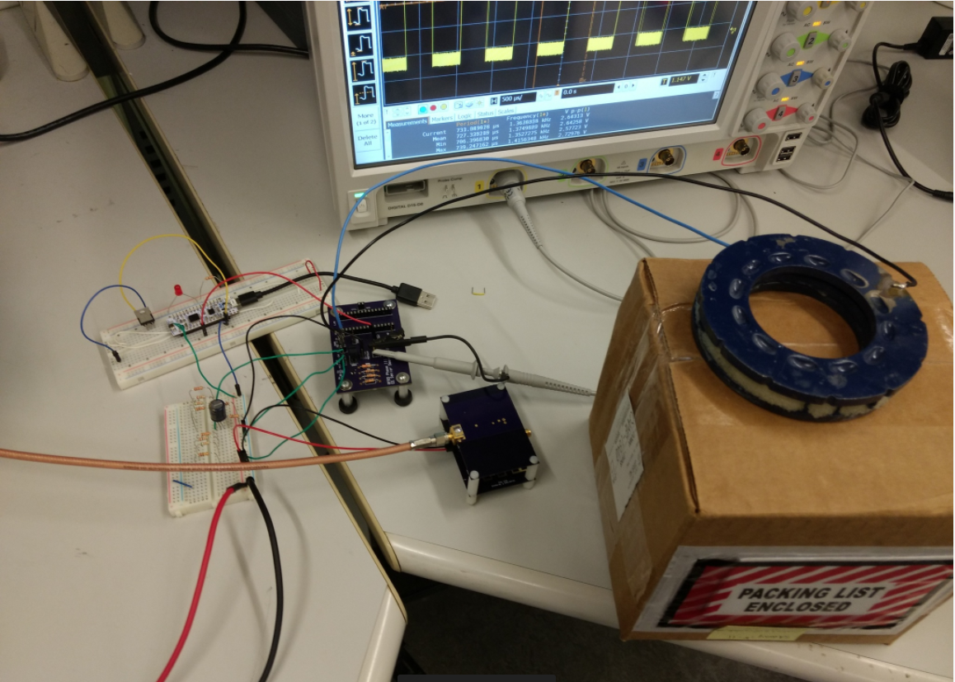
System Testing Setup
Washers
Microcontroller
Capacitance Measuring PCB
Rectifier
Rx Antenna
Tx Antenna

Slide 25
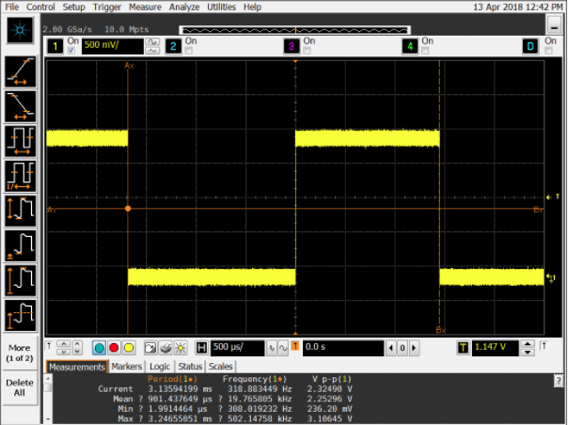
System Testing Results
Resting Washer

Slide 26
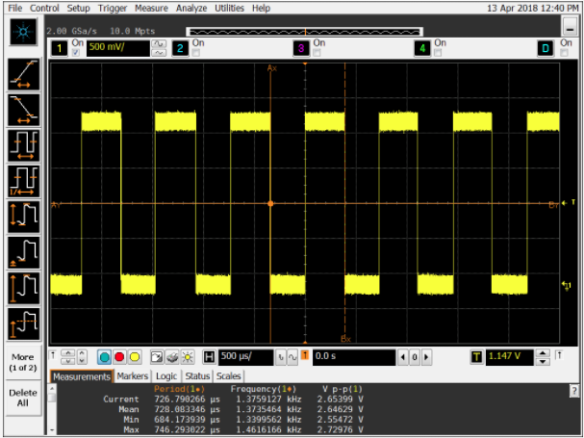
System Testing Results
Pressured Washer

Slide 27
System Testing Results
Demonstrated wireless operation at 3.25 inches from Tx to Rx antenna
Signal generator supplied 15.5 dBm at 887 MHz to the Tx antenna
To guarantee 2 volts DC supplied to PCB
Microcontroller and capacitance measuring circuit fully operational
Successfully operated with washer design
Triggered LED when pressured

Slide 28
End of Project Results
Capacitance Measuring:
Functional design and PCB
Low power operation
Antenna/Rectifier Design:
Simulated antenna/rectifier
Modeled PCB design
Microcontroller Design:
Functional firmware and PCB
System Design:
Successful demonstration of wireless functionality
Measured washer design with capacitance measuring circuit
Triggered LED with microcontroller threshold
Notes:
Add Gantt chart afterwards

Slide 29
Future Revisions
Capacitance Measuring:
Scalability of the PCB
Antenna/Rectifier Design:
Fabricate the PCB
Test the PCB
Implement backscatter
Microcontroller Design:
Persistent tag ID and data tracking
Implement protocol
Communication to RF reader
Notes:
Add Gantt chart afterwards

Slide 30
References
Liu, Yili, et al. “Limitations of a relaxation oscillator in capacitance measurements.” IEEE Transactions on Instrumentation and Measurement, vol. 49, no. 5, 2000, pp. 980–983., doi:10.1109/19.872917.
Tuttle, Dr. Gary. “Non Linear Oscillators.” EE 230 Website, Dr. Gary Tuttle, tuttle.merc.iastate.edu/ee230/topics/op_amps/non_linear_oscillators.pdf.
“TS881 Rail-To-Rail 0.9 V nanopower comparator.” www.st.com/content/ccc/resource/technical/document/datasheet/a2/60/3e/5d/b2/c1/4a/e9/DM00057901.pdf/files/DM00057901.pdf/jcr:content/translations/en.DM00057901.pdf.
Zeng, Miaowang, et al. “A Compact Fractal Loop Rectenna for RF Energy Harvesting.” IEEE Antennas and Wireless Propagation Letters, vol. 16, 2017, pp. 2424–2427., doi:10.1109/lawp.2017.2722460.
Kervel, Fredirk. “868 MHz, 915 MHz and 955 MHz Inverted F Antenna.” www.ti.com/lit/an/swra228c/swra228c.pdf.
Technologies, Avago. “Linear Models forDiode Surface Mount Packages.”www.avagotech.com, 21 July 2010, ddd.uab.cat/pub/trerecpro/2010/hdl.../PFC_SergiCarreraColet_annex.pdf.
STMicroelectronics. “Access Line Ultra-Low-Power 32-Bit MCU Arm®-Based Cortex®-M0 , up to 16KB Flash, 2KB SRAM, 512B EEPROM, ADC.”www.st.com/resource/en/datasheet/stm32l011d4.pdf.
STMicroelectronics. “STM32 Nucleo-32 board.”http://www.st.com/resource/en/data_brief/nucleo-f031k6.pdf.

Slide 32
Clocks

Slide 33
Peripherals

Slide 34
Final Code
#define THRESHOLD_PERIOD 857
#define THRESHOLD_FREQUENCY (1000000/THRESHOLD_PERIOD)
uint16_t first_cap = 0;
uint16_t last_cap = 0;
while (1){
first_cap = HAL_LPTIM_ReadCounter(&hlptim1); //read initial timer count
HAL_Delay(1000); //wait while number of cycles is counted
last_cap = HAL_LPTIM_ReadCounter(&hlptim1); //read second count value
uint16_t cycles = last_cap - first_cap; //calculate cycles during period
if (last_cap < first_cap){ //handle overflow of counter
cycles = (last_cap + 0xFFFF) - first_cap;
}
if (cycles > (THRESHOLD_FREQUENCY )){ //if the washer is not pressed
HAL_GPIO_WritePin(GPIOB, GPIO_PIN_3, GPIO_PIN_RESET); //LED off
} else {
HAL_GPIO_WritePin(GPIOB, GPIO_PIN_3, GPIO_PIN_SET); //LED on
}
}

